Slide 1
GIPER Instrument Design

Slide 2
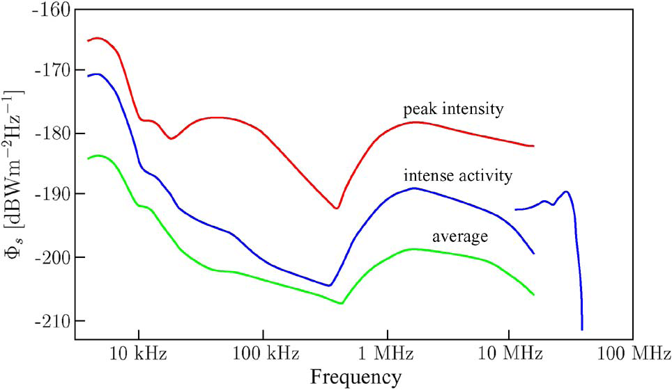
Jupiter Radio Emission Spectrum Density
Source: A. Giovanni [2]

Slide 3
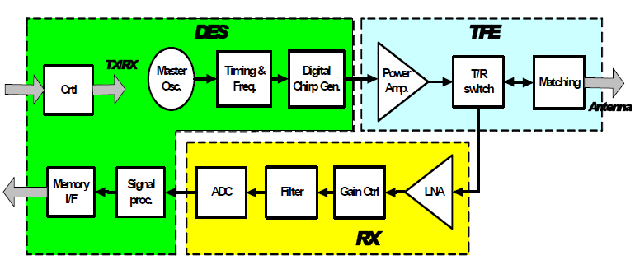
GIPER Architecture
Source : L. Bruzzone [1]

Slide 4
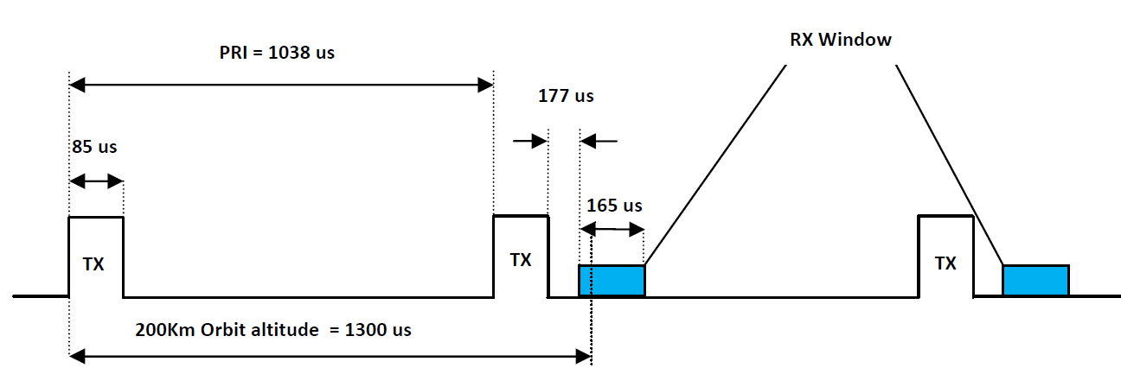
GIPER Timing Diagram
60 us ice travel (5 Km)
85 us pulse width
10 us safety margin each side

Slide 5
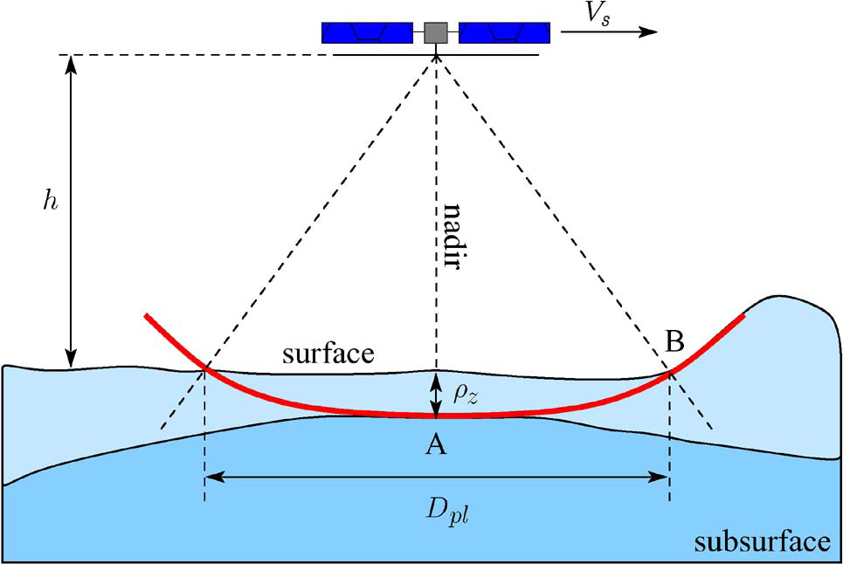
GIPER Operation
Source: A. Giovanni [2]

Slide 6
GIPER Link Budget
Picture source: A. Giovanni [2]

Slide 7
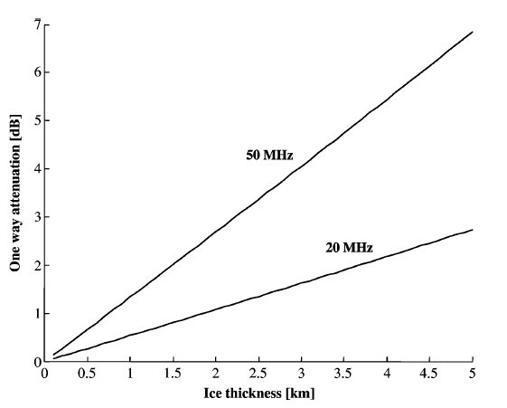
Attenuation inside Ice
Picture source: A. Giovanni [2]

Slide 8
GIPER Link Budget
For crater/ice
For Slush

Slide 9
Signal to Noise Ratio
For surface echo
For crater/ice
For Slush

Slide 10
Range Resolution
For Ice

Slide 11
Ground Resolution
Fresnel circle
For coherent scattering
Pulse limited circle
For Incoherent scattering

Slide 12
Synthetic Aperture Processing

Slide 13
GIPER Characteristics
Parameter | Value
Orbit Altitude | 200Km
Centre Frequency | 45MHz
Chirp Bandwidth | 10MHz
PRF | 963.39Hz
Pulse Width | 85us
Ice Range Resolution | 8.6m
Along Track Resolution | 817m
Across Track Resolution | 4899m
SNR (surface echo) | 26.9dB
Power | 20W
Mass | 10Kg

Slide 14
References
[1] L. Bruzzone A. Ferro Angelo Olivieri Roberto Seu R. Orosei G. Alberti S. Mattei and C. Catallo. “Preliminary performance of Sub-Surface Radar for the EJSM/Laplace Mission.” IEEE Proceddings (2009).
[2] Giovanni A. Lorenzo B. and et al. “Subsurface Radar Sounding of the JovianMoon Ganymede”. In: Proceedings of the IEEE (2011).

